Slide 1
Teradata Training
12-- 12/03/2018

Slide 2
Topics
Table Types
Derived Table
Volatile Table
Global Temporary Table
Space Concepts
Permanent Space
Spool Space
Temp Space
Secondary Index
Unique Secondary Index (USI)
Non-Unique Secondary Index (NUSI)
Statistics --MVC
Explain

Slide 3
Tables
Tables | Syntax
Derived Table | SELECT Emp.EmployeeNo, Emp.FirstName, Empsal.NetPay FROM testdb1.Employee Emp, (select EmployeeNo, NetPay from testdb1.empSalary where NetPay >= 75000) Empsal where Emp.EmployeeNo = Empsal.EmployeeNo;
Volatile Table | CREATE VOLATILE SET TABLE dept_stat ( dept_no INTEGER, avg_salary INTEGER, max_salary INTEGER, min_salary INTEGER ) PRIMARY INDEX(dept_no) ON COMMIT PRESERVE ROWS;

Slide 4
Tables
Tables | Syntax
Global Temporary Table | CREATE SET GLOBAL TEMPORARY TABLE Testdb1.dept_stat1 ( dept_no INTEGER, avg_salary INTEGER, max_salary INTEGER, min_salary INTEGER ) PRIMARY INDEX(dept_no);
Global Temporary Table | CREATE MULTISET GLOBAL TEMPORARY TABLE Testdb1.dept_stat ( dept_no INTEGER, avg_salary INTEGER, max_salary INTEGER, min_salary INTEGER ) PRIMARY INDEX(dept_no);

Slide 5
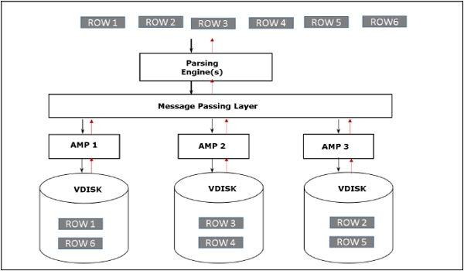
Architecture

Slide 6
Space Concepts
Space | Definition
Permanent Space | Permanent space is not pre-allocated for the database/user. They are just defined as the maximum amount of space the database/user can use. The amount of permanent space is divided by the number of AMPs. Whenever per AMP limit exceeds, an error message is generated
Spool Space | Users without spool space cannot execute any query. Similar to Permanent space, spool space defines the maximum amount of space the user can use. Spool space is divided by the number of AMPs. Whenever per AMP limit exceeds, the user will get a spool space error.
Temp Space | Temp space is the unused permanent space which is used by Global Temporary tables. Temp space is also divided by the number of AMPs.

